Slide 1

Operating systems
Lecture # 02

Slide 2
Lecture Overview
Types of Operating System (OS)
Batch OS
Multi Programmed OS
Multitasking OS
Real Time OS
Distributed OS
Clustered OS
Embedded

Slide 3
Batch operating system
Batch operating systems used in mainframe computers, users did not interact directly with the computer. Jobs (programs with data) were collected in batches and executed one after another.
Some activities that the operating system performs for batch processing are:
It identifies the set of jobs that are further assigned to a sequence of commands.
The operating system executes list of number jobs that it maintains in the memory one by one which is based on some scheduling algorithm.
It follows a first come first serve manner which means the job in the operating system that have been submitted first are processed first

Slide 4
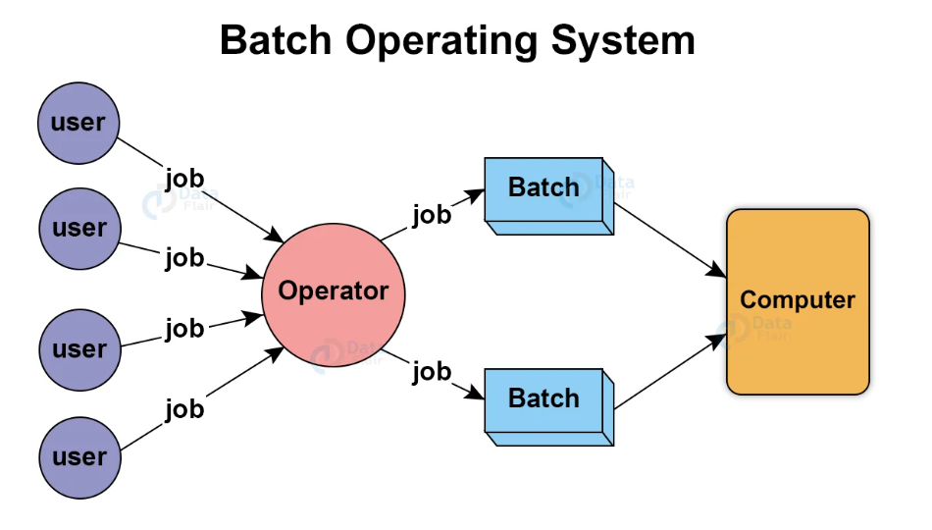

Slide 5
Advantages:
Repeated jobs can be processed quickly and automatically.
No user intervention required once the batch starts.
Does not require special hardware or manual supervision.
Ideal for large organizations handling repetitive data jobs.
Disadvantages:
No direct interaction between user and system during execution.
Users must wait until the entire batch completes to see results.
Debugging and error fixing are difficult since errors are found after the batch is done.

Slide 6
Multi programmed
A multiprogrammed OS allows multiple programs to reside in main memory at the same time.
The CPU always has something to execute, when one program waits for I/O (like reading from disk), the CPU switches to another job.
This technique helps achieve maximum CPU utilization and reduces system idle time
Example: In a single-tasking system, the CPU is not used if the current program waits for some input/output to finish. The idea of multiprogramming is to assign CPUs to other processes while the current process might not be finished.

Slide 7
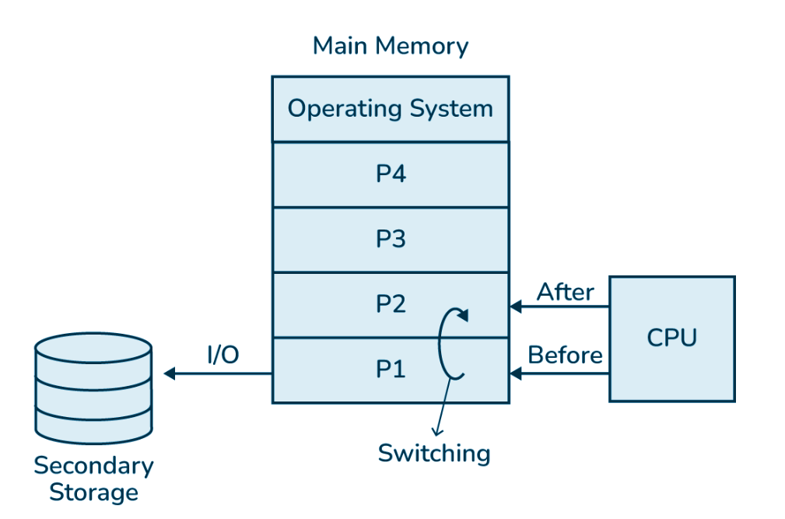

Slide 8
Multi tasking / Time sharing
CPU performs multitasking by switching multiple jobs and executing them simultaneously. The process of switching between the jobs is performed in a very frequent and quick manner.
Some activities that the operating system performs related to multitasking are:
When the user gives any instruction to the operating system, directly it receives a very quick and immediate response.
Multitasking operating systems also known as time-sharing systems were initially developed at a very reasonable price to provide interactive use of the system
Questions?
- Multi Programmed VS Multi Tasking? – CPU Idleness / Responsiveness
Preemptive VS Non- Preemptive?
Multiprogramming VS Multiprogrammed – Process/Environment
Which type of OS is used in Laptop: Multiprogrammed or Multitasking?

Slide 9
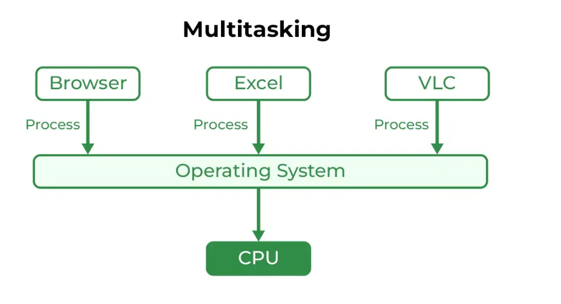

Slide 10
Real - time os
In such systems, the time interval required to process and respond to inputs is very small. This time interval is called response time.
Real-time systems are used when there are time requirements that are very strict like missile systems, air traffic control systems, robots, etc.
Types of RTOS:
Hard Real Time Systems: Hard Real-Time OSs are meant for applications where time constraints are very strict and even the shortest possible delay is not acceptable.
Soft Real Time Systems: These OSs are for applications where time is less strict.

Slide 11
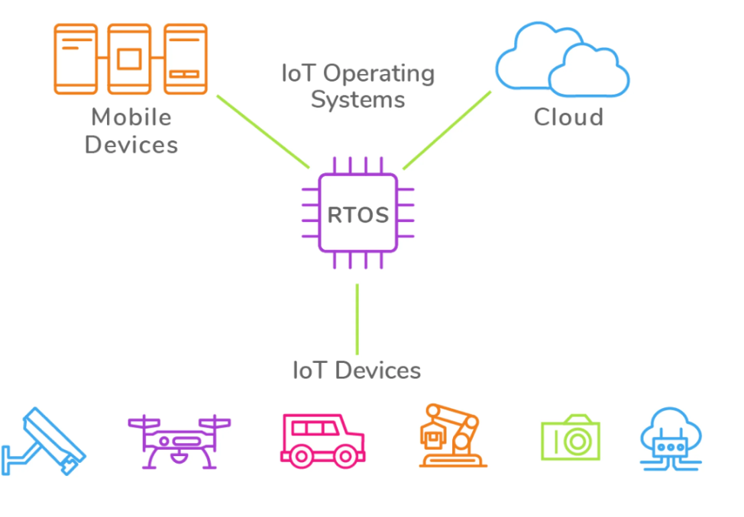

Slide 12
Distributed / clustering os
A Distributed Operating System connects multiple independent computers through a network to act as a single unified system. Each computer has its own CPU and memory but works together to share resources and tasks.
Key Points:
Multiple autonomous systems communicate via a shared network.
Enables remote access to files and software on other connected systems.
Improves resource utilization, speed, and reliability.

Slide 13
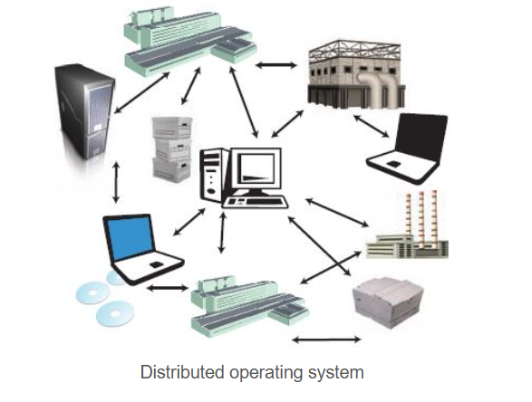
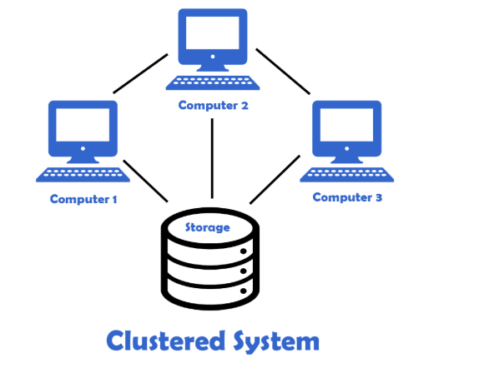

Slide 14
Feature / Aspect | Distributed Operating System | Clustered Operating System
Definition | Manages a group of independent computers connected via a network to appear as a single system. | Connects multiple computers (nodes) that work together closely, often sharing storage and tightly coupled.
Architecture | Loosely coupled — systems connected through LAN/WAN. | Tightly coupled — systems share common resources (e.g., shared disks).
Goal / Purpose | Resource sharing, load balancing, and remote access. | High availability, fault tolerance, and improved performance.
Communication | Communication through a network (message passing). | Communication through a shared system bus or high-speed connection.
Resource Sharing | Distributed among multiple systems. | Shared among clustered nodes.
Failure Handling | If one node fails, others continue — distributed recovery. | Redundant nodes take over failed ones — failover mechanism.
Example | Amoeba, LOCUS, Google File System. | Windows Server Cluster, IBM HACMP, Oracle RAC.

Slide 15
Question for you?
What is Embedded & Android Operating System ?

Slide 16
Thank you!
Remember: when in doubt — restart the system 😉

